Slide 1



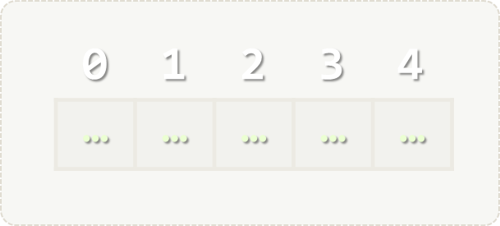
Arrays and Lists
Processing Sequences of Elements
Arrays
Lists
SoftUni Team
Technical Trainers
Software University
http://softuni.bg

Slide 2

Table of Contents
Value vs Reference Types
Defining, Initializing and Processing Arrays
Reading and Writing Arrays
Defining, Initializing and Processing Lists
Sorting Lists and Arrays

Slide 3
Questions?
sli.do #Tech

Slide 4
Value vs Reference Types
Memory Stack and Heap

Slide 5
Value types
List of Value Types - https://msdn.microsoft.com/en-us/library/bfft1t3c.aspx
Variables of value types directly contain their data.
With value types, each variable has its own copy of the data, and it is not possible for operations on one variable to affect the other

Slide 6
Reference types
Some of the reference types – string, DateTime, TimeSpan, Random, any other classes, interfaces, delegates and more.
Variables of reference types store references to their data.
With reference types, two variables can reference the same object; therefore, operations on one variable can affect the object referenced by the other variable.

Slide 7
Value vs Reference Types

Slide 8
Example: Value Types
public static void Main(string[] args)
{
int num = 5;
Increment(num, 15);
Console.WriteLine(num);
}
private static void Increment(int num, int value)
{
num += value;
}

Slide 9
Example: Reference Types
public static void Main(string[] args)
{
int[] nums = { 5 };
Increment(nums, 15);
Console.WriteLine(nums[0]);
}
private static void Increment(int[] nums, int value)
{
nums[0] += value;
}

Slide 10
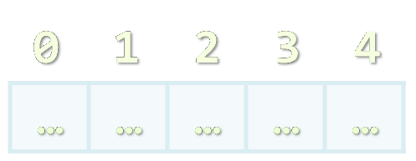
Arrays
Working with Arrays of Elements

Slide 11
What are Arrays?
In programming array is a sequence of elements
Elements are numbered from 0 to Length-1
Elements are of the same type (e.g. integers)
Arrays have fixed size (Array.Length) – cannot be resized
0 1 2 3 4
Element index
Array of 5 elements
… | … | … | … | …
Element of an array

Slide 12
Working with Arrays
All elements are initially == 0
Allocating an array of 10 integers:
Assigning values to the array elements:
Accessing array elements by index:
int[] numbers = new int[10];
The Length holds the number of array elements
for (int i = 0; i < numbers.Length; i++)
numbers[i] = 1;
The [] operator accesses elements by index
numbers[5] = numbers[2] + numbers[7];
numbers[10] = 1; // IndexOutOfRangeException

Slide 13
Days of Week – Example
The days of week can be stored in array of strings:
string[] days = {
"Monday",
"Tuesday",
"Wednesday",
"Thursday",
"Friday",
"Saturday",
"Sunday"
};
Expression | Value
days[0] | Monday
days[1] | Tuesday
days[2] | Wednesday
days[3] | Thursday
days[4] | Friday
days[5] | Saturday
days[6] | Sunday

Slide 14
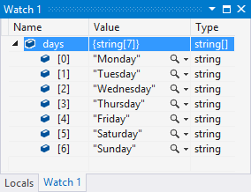
Problem: Day of Week
Enter a day number [1…7] and print the day name (in English) or "Invalid day!"
Check your solution here: https://judge.softuni.bg/Contests/Practice/Index/172#0

Slide 15
Solution: Day of Week
string[] days = { "Monday", "Tuesday", "Wednesday", "Thursday", "Friday", "Saturday", "Sunday" };
int day = int.Parse(Console.ReadLine());
if (day >= 1 && day <= 7)
{
Console.WriteLine(days[day - 1]);
}
else
{
Console.WriteLine("Invalid day!");
}
Check your solution here: https://judge.softuni.bg/Contests/Practice/Index/172#0

Slide 16

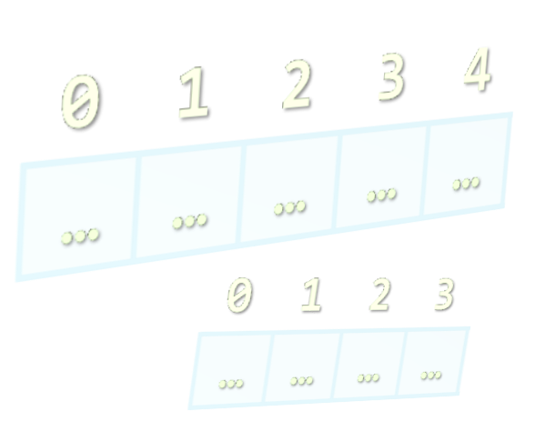
Reading Arrays from the Console
Using String.Split()

Slide 17
Reading Arrays From the Console
First, read from the console the array length:
Next, create an array of given size n and read its elements:
int n = int.Parse(Console.ReadLine());
int[] arr = new int[n];
for (int i = 0; i < n; i++)
{
arr[i] = int.Parse(Console.ReadLine());
}

Slide 18
Reading Array Values from a Single Line
Arrays can be read from a single line of space separated values:
2 8 30 25 40 72 -2 44 56
string values = Console.ReadLine();
string[] items = values.Split(' ');
int[] arr = new int[items.Length];
for (int i = 0; i < items.Length; i++)
{
arr[i] = int.Parse(items[i]);
}
string.Split(' ') splits string by space and produces string[]

Slide 19
Printing Arrays on the Console
To print all array elements, a for-loop can be used
Separate elements with white space or a new line
Example:
string[] arr = {"one", "two", "three", "four", "five"};
// Process all array elements
for (int index = 0; index < arr.Length; index++)
{
// Print each element on a separate line
Console.WriteLine("arr[{0}] = {1}", index, arr[index]);
}

Slide 20
Problem: Reverse an Array of Integers
Read an array of integers (a number n + n lines of integers), reverse it and print its elements (on a single line, space separated):
3
10
20
30
30 20 10
4
-1
20
99
5
5 99 20 -1
Check your solution here: https://judge.softuni.bg/Contests/Practice/Index/172#1

Slide 21
Solution: Reverse an Array of Integers
// Read the array (a number n + n lines of integers)
var n = int.Parse(Console.ReadLine());
var arr = new int[n];
for (int i = 0; i < n; i++)
arr[i] = int.Parse(Console.ReadLine());
// Print the elements from the last to the first
for (int i = n-1; i >= 0; i--)
Console.Write(arr[i] + " ");
Console.WriteLine();
Check your solution here: https://judge.softuni.bg/Contests/Practice/Index/172#1

Slide 22
Problem: Rounding Numbers
Read an array of real numbers (space separated values), round them in "away from 0" style and print the output as in the examples:
0.9 1.5 2.4 2.5 3.14
-5.01 -1.599 -2.5 -1.50 0
0.9 => 1
1.5 => 2
2.4 => 2
2.5 => 3
3.14 => 3
-5.01 => -5
-1.599 => -2
-2.5 => -3
-1.50 => -2
0 => 0
Check your solution here: https://judge.softuni.bg/Contests/Practice/Index/172#4

Slide 23

Solution: Rounding Numbers
Rounding turns each value to the nearest integer
double[] nums = ReadNumbers();
int[] roundedNums = new int[nums.Length];
for (int i = 0; i < nums.Length; i++)
roundedNums[i] = (int) Math.Round(nums[i],
MidpointRounding.AwayFromZero);
for (int i = 0; i < nums.Length; i++)
Console.WriteLine($"{nums[i]} -> {roundedNums[i]}");
Check your solution here: https://judge.softuni.bg/Contests/Practice/Index/172#4

Slide 24
Printing Arrays with foreach / String.Join(…)
Use foreach-loop:
Use string.Join(separator, array):
int[] arr = { 10, 20, 30, 40, 50};
foreach (var element in arr)
Console.WriteLine(element)
int[] arr = { 1, 2, 3 };
Console.WriteLine(string.Join(", ", arr)); // 1, 2, 3
string[] strings = { "one", "two", "three", "four" };
Console.WriteLine(string.Join(" - ", strings)); // one - two - three - four

Slide 25
Problem: Reverse Array of Strings
Read an array of strings (space separated values), reverse it and print its elements:
Reversing array elements:
a b c d e
e d c b a
-1 hi ho w
w ho hi -1
exchange
a
b
c
d
e
Check your solution here: https://judge.softuni.bg/Contests/Practice/Index/172#5

Slide 26
Solution: Reverse Array of Strings
var nums = Console.ReadLine().Split(' ').ToArray();
for (int i = 0; i < nums.Length / 2; i++)
SwapElements(nums, i, nums.Length - 1 - i);
Console.WriteLine(string.Join(" ", nums));
static void SwapElements(string[] arr, int i, int j)
{
var oldElement = arr[i];
arr[i] = arr[j];
arr[j] = oldElement;
}
Check your solution here: https://judge.softuni.bg/Contests/Practice/Index/172#5

Slide 27

Arrays – Exercises
Live Exercises in Class (Lab)

Slide 28
List<T> Overview
2
10
5

Slide 29
List<T> – Data Structure
List<T> holds a list of elements
Count – the number of elements in the List<T>
Add() – adds an element to the List<T>
Remove() – returns true if it finds the element and removes it
Insert() – inserts an element to given position
Contains() – determines whether an element is in the stack

Slide 30
Add() – Adds an element
10
5
2
List<int>
2
0
1
Count:
3

Slide 31
Remove() – returns true if it finds the element and removes it
10
List<int>
2
Count:
3
2
10
5

Slide 32
Insert() – inserts an element to given position
-5
List<int>
3
Count:
2
2
5

Slide 33
Lists – Exercises
Live Exercises in Class (Lab)

Slide 34
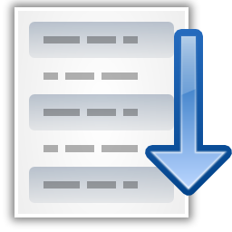


Sorting Lists and Arrays

Slide 35
Sorting Lists and Arrays
Sorting a list == reorder its elements incrementally
List items should be comparable, e.g. numbers, strings, dates, …
var names = new List<string>() {
"Nakov", "Angel", "Ivan", "Atanas", "Boris" };
names.Sort();
Console.WriteLine(string.Join(", ", names));
// Angel, Atanas, Boris, Ivan, Nakov
names.Sort((a, b) => b.CompareTo(a));
Console.WriteLine(string.Join(", ", names));
// Nakov, Ivan, Boris, Atanas, Angel
Sort in natural order (ascending)
Sort in descending order

Slide 36
Problem: Sort Numbers
Read a list of decimal numbers and sort them
8 2 7 3
2 <= 3 <= 7 <= 8
1 1
1 <= 1
2 4 -9
-9 <= 2 <= 4
1 -0.5
-0.5 <= 1
Check your solution here: https://judge.softuni.bg/Contests/Practice/Index/172#13

Slide 37
Solution: Sort Numbers
string[] input = Console.ReadLine().Split(' ');
List<double> nums = new List<double>();
foreach(string num in input)
{
nums.Add(double.Parse(num));
}
nums.Sort();
Console.WriteLine(string.Join(" <= ", nums));
Check your solution here: https://judge.softuni.bg/Contests/Practice/Index/172#13

Slide 38
Problem: Square Numbers
Read a list of integers and print all square numbers in the list in descending order
A "square number" s is a square of some other integer: s = x * x
3 16 4 5 6 8 9
16 9 4
var squares = new List<int>();
foreach (var num in nums)
if (√num == (int)√num) squares.Add(num);
// TODO: sort squares descending and print them
Check your solution here: https://judge.softuni.bg/Contests/Practice/Index/172#14

Slide 39
Problem: Count Numbers
Read a list of integers in range [0…1000] and print them in ascending order along with their number of occurrences
8 2 2 8 2 2 3 7
10 8 8 10 10
0 5 0 0 1 0
2 -> 4
3 -> 1
7 -> 1
8 -> 2
8 -> 2
10 -> 3
0 -> 4
1 -> 1
5 -> 1
Check your solution here: https://judge.softuni.bg/Contests/Practice/Index/172#15

Slide 40
Solution: Count Numbers (Simple)
var nums = Console.ReadLine().Split(' ')
.Select(int.Parse).ToList();
var counts =
new int[nums.Max() + 1];
foreach (var num in nums)
counts[num]++;
for (int i = 0; i < counts.Length; i++)
if (counts[i] > 0)
Console.WriteLine($"{i} -> {counts[i]}");
counts[num] holds how many times num occurs in the list
Check your solution here: https://judge.softuni.bg/Contests/Practice/Index/172#15

Slide 41
Solution: Count Numbers (by Sorting)
List<int> nums = ReadNumbers();
nums.Sort();
var pos = 0;
while (pos < nums.Count)
{
int num = nums[pos], count = 1;
while (pos + count < nums.Count &&
nums[pos + count] == num)
count++;
pos = pos + count;
Console.WriteLine($"{num} -> {count}");
}
Sort the numbers
Count how times num occurs starting from position pos
Check your solution here: https://judge.softuni.bg/Contests/Practice/Index/172#15

Slide 42
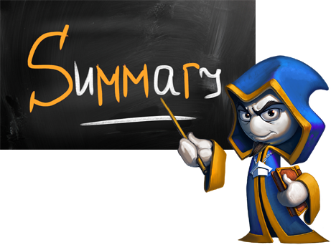
Summary
Arrays hold sequence of elements
Elements are numbered from 0 to length-1
Creating (allocating) an array/list:
Accessing array/list elements by index:
Printing array/list elements:
int[] numbers = new int[10];
List<int> nums = new List<int>();
numbers[5] = 10;
Console.Write(string.Join(" ", arr));

Slide 43








Arrays and Lists
https://softuni.bg/courses/programming-fundamentals

Slide 44
License
This course (slides, examples, demos, videos, homework, etc.) is licensed under the "Creative Commons Attribution-NonCommercial-ShareAlike 4.0 International" license
Attribution: this work may contain portions from
"Fundamentals of Computer Programming with C#" book by Svetlin Nakov & Co. under CC-BY-SA license

Slide 45






Free Trainings @ Software University
Software University Foundation – softuni.org
Software University – High-Quality Education, Profession and Job for Software Developers
softuni.bg
Software University @ Facebook
facebook.com/SoftwareUniversity
Software University @ YouTube
youtube.com/SoftwareUniversity
Software University Forums – forum.softuni.bg

